Slide 1
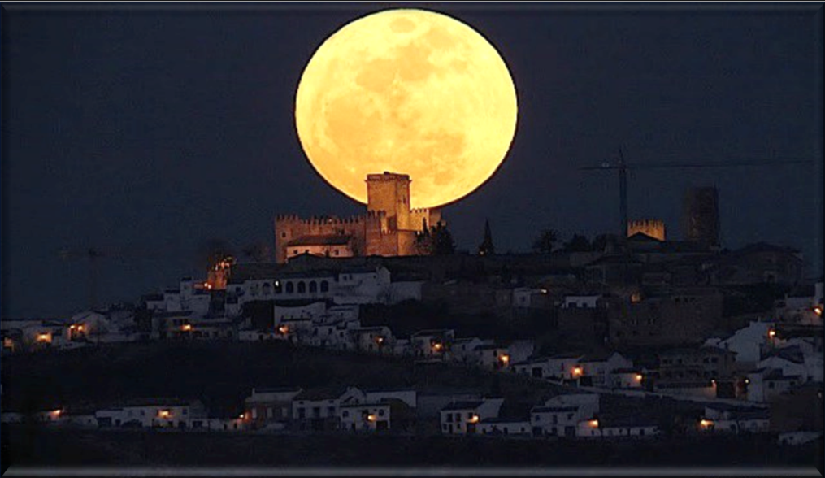

Yahusha’s Contempt
for the Jews’
Lunar Feast of Tabernacles
John 7 Part 3
Comparing the Two Calendars
Notes:
5.11b John 7 Part 3 Yahusha’s Contempt [64] TA 4 Feb 2023
No teaser for part 3 – part 2 teaser was for both parts 2 & 3.
Website: https://studythecalendar.com/5-9-john-7-yahusha-the-jews-feast-of-tabernacles-part-1
You-tube launch: https://youtu.be/hGNASwHCGkg
Time: 1 hr 52 min:
Blurb 5.11b:

Slide 2
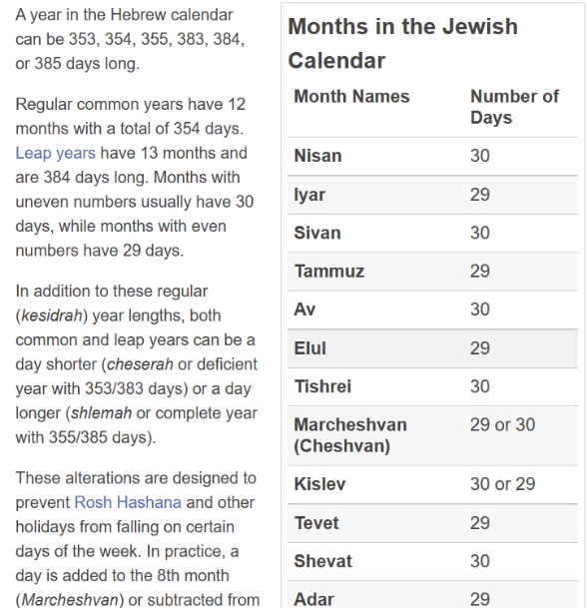
The dates on the
Lunar Calendar for
29 CE will follow the guidelines as given according to these
Rules for the
“Hebrew” Calendar.
Will the information align with John 7?
Note for the following lunar calendar: The sliver moon is sighted at sunset. This ushers in the Night Season of the 1st day, but the Day Season is not until the next calendar “date.”
https://www.timeanddate.com/calendar/jewish-calendar.html

Slide 3
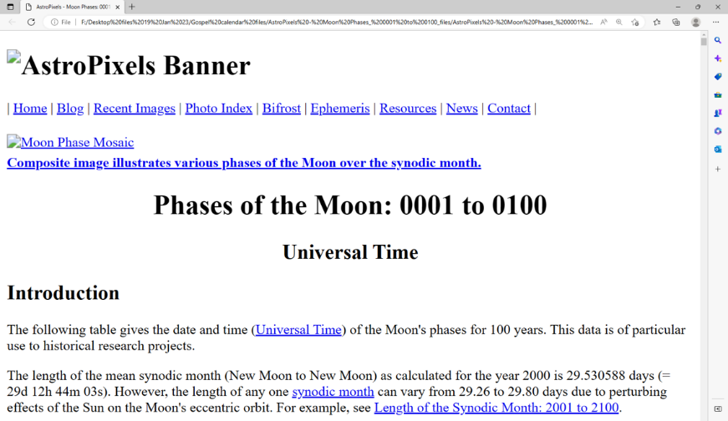
Comparing Dates of Moon Phases With 2 Different Sources
Please see: http://astropixels.com/ephemeris/phasescat/phases0001.html
This document will be used to compare the moon phases to what is found on the 29 CE Israel Calendar.

Slide 4
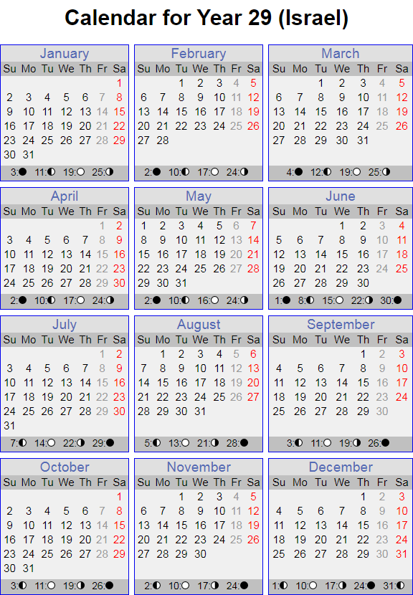

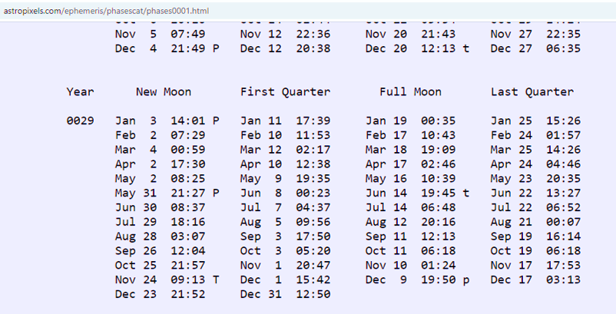

Two Different Sources for Moon Phases
Website: http://astropixels.com/ephemeris/phasescat/phases0001.html
Phases of the Moon: 0029 - Universal Time (UT)
Note: For such an important study in John 7,
every effort is being made to show the monthly count
for the lunar calendar in use in this chapter for 29 CE.
In 29 CE there are 50 moon phases.
In comparison to the moon phases with the Israel calendar [29 CE], nine phases vary only a slight amount.

Slide 5
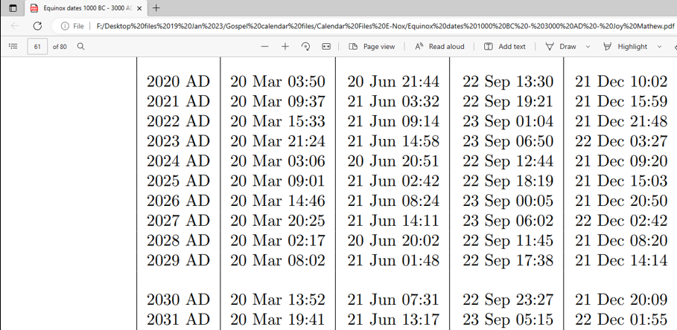
Comparing Spring Tequfah Dates From Different Sources
Please see: https://www.weather.gov/media/ind/seasons.pdf
[Internet Document]
Earth Seasons - Equinoxes - 2022-2026 from the U.S. Naval Observatory, Astronomical Applications Department for the Spring Vernal Equinox
Note the accuracy of tequfah timing with the comparison of 5 years between 2022-2026 from two different sources.
[UTC=Grenwich UK Time]
Table for tequfah (equinox) dates from 1000 BCE to 3000 CE.
The 2023 tequfah date
is the same as Covenant Calendar is expecting in 2023 (p 61).
Please take the time to notice that from 2020 to 2031 Mar 20th is the tequfah date at Greenwich UK [UTC]
each year.
Please note all tequfah markers move forward about
6 hours each year. Fall tequfah dates vary between the 22nd & 23rd.
2022... MAR 20 2022 1133 AM EDT - 1533 UTC
2023... MAR 20 2023 524 PM EDT - 2124 UTC
2024... MAR 19 2024 1106 PM EDT - 0306 UTC MAR 20
2025... MAR 20 2025 501 AM EDT - 0901 UTC
2026... MAR 20 2026 1046 AM EDT - 1446 UTC

Slide 6
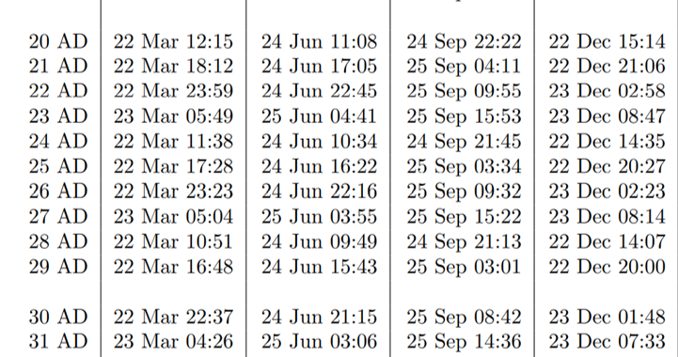

Spring Tequfah Dates for 20 CE to 31 CE
Mar 22
is the tequfah date that will be used …
Please see: https://www.beda.cz/~jirkaj/seasons/seasons.pdf
The same table for the tequfah (equinox) dates from 1000 BCE to 3000 CE
also verifies
in 29 CE
the tequfah occurred on
Mar 22nd.
Please
take the time to notice
that from
20 to 31 CE
Mar 22 & 23 share the tequfah date.
Please note all tequfah markers move forward about
6 hours
each year.
Fall tequfah dates vary between the 24th & 25th.
… for the count of both the Lunar and Covenant Calendars.

Slide 7

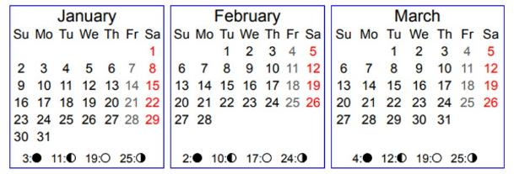
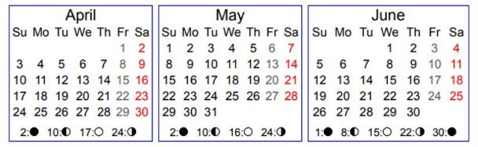
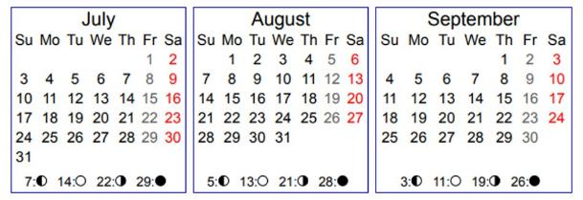
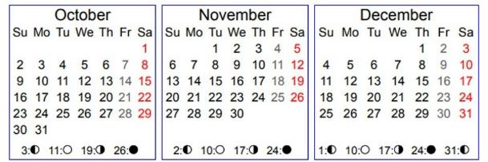
29 CE Lunar Calendar: Year-start AFTER Equinox
Equinox: Mar 22
This calendar follows the Jewish month lengths of 30-29-30 etc.
Is the full moon on the 14th day of every month?
LUNAR CALENDAR KEY CODE
ss = sunset (eg) Day 14 begins @ sunset
New Month day begins @ sunset
14th Day of the Month (Full Moon?)
Day of Atonement (Yom Kippur Oct 7/8)
Week of Sukkot – 8 days (Oct 12-20)
Mar 22nd Tequfah
1st Nisan 30 days Day 1 ss Apr 4
Day 14 PO @ ss Apr 17
Day 30 ss May 3
2nd Iyar 29 days
Day 1 ss May 4
Day 14 @ ss May 17 Day 29 ss Jun 1
3rd Sivan 30 days
Day 1 ss Jun 2
Day 14 @ ss Jun 15
Day 30 ss Jul 1
4th Tammuz 29 days
Day 1 ss Jul 2
Day 14 @ ss Jul 15
Day 29 ss Jul 30
5th Av 30 days
Day 1 ss Jul 31
Day 14 @ ss Aug 13
Day 30 ss Aug 29
6th Elul 29 days
Day 1 ss Aug 30
Day 14 @ ss Sep 12
Day 29 ss Sep 27
7th Tishri 30 days
Day 1 ss Sep 28 Trumpets
Day 14 @ ss Oct 11
Day 30 ss Oct 27
8th Chesh. 29/[30]
Day 1 ss Oct 28
Day 14 @ ss Nov 10
Day 29 ss Nov 25
9th Kislev 30/[29]
Day 1 ss Nov 26
Day 14 @ ss Dec 9
Day 30 ss Dec 25
10th Tevet 29 days
Day 1 ss Dec 26
Day 14 in Jan
Day 29 In Jan

Slide 8
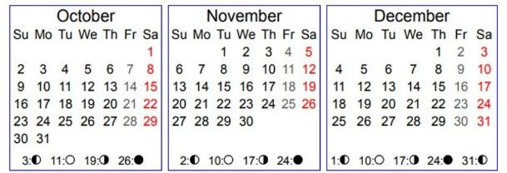
29 CE Covenant Calendar: Year-start After Equinox
Equinox: Mar 22
According to Covenant Calendar counting, the festal calendar
begins “at daybreak” the day after the spring tequfah/equinox.
All months for Covenant Calendar are counted out as 30 days each.
Passover Apr 5th
2nd Mon
Apr 22
3rd Mon
May 22
4th Mon
Jun 21
1st Mon – Abib 1
Mar 23
5th Mon
Jul 21
6th Mon
Aug 20
7th Mon
Sep 19
8th Mon
Oct 19
9th Mon
Nov 18
10th Mon
Dec 18

Slide 9
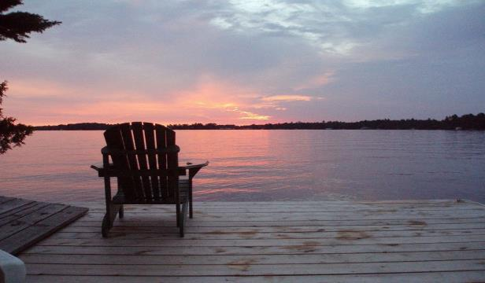

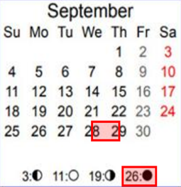
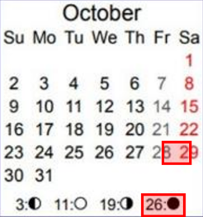


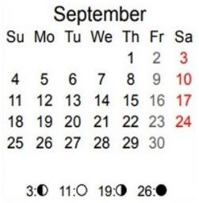
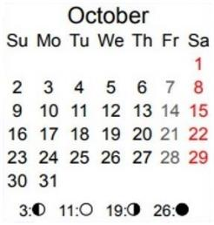
Attention:
The counting of
festivals that begin
with the sunset
“day-start” tend
to be very
challenging!
L
U
N
A
R
7th Month; 1st Day
@ Sep 28th Sunset
8th Month; 1st Day
@ Oct 28th Sunset
COVENANT
Because most lunar calendars begin each “new day” at sunset, the best way to illustrate this is by off-setting the boxes between two Roman calendar dates. (e.g.: The 1st day of
the 7th month begins at sunset on Sep 28th.)
Covenant Calendar cycles begin
with the dawn twilight.
7th Month; 1st Day
@ Dawn Sep 19th
8th Month; 1st Day
@ Dawn Oct 19th

Slide 10



You have seen where the 12 festival months place on the Roman Calendar for both calendars. Now we can chart both sets of dates on the Roman Calendar for the Feast of Tabernacles in the 7th month.
Next: Initial workup for BOTH Calendars
7th Month
1st: Trumpets
10th: Yom Kippur
15th – 21st
Sukkot (7 days)
22nd: Last Great Day

Slide 11
Linear Calendar Orientation
We all know how to read the Roman Calendar. John 7 will be demonstrated on this linear calendar showing the strict & simple alignment between the Lunar calendar and the Covenant calendar in this study.
Year 29 CE – is the year date on
the Roman Calendar that begins
the first month of January.
Year 30 CC – is the year date for Covenant Calendar that begins the day after the 29 CE spring tequfah [equinox] in the N Hemisphere.
Cycle of the Week – listed on the left side of each column.
Date of the Festal Month – listed on the right side of each column.
Weekly Sabbaths – are designated by the blue line. Both lunar and covenant calendars are aligned according to the weekly Sabbaths.
Following is a visual demonstration of how these 2 linear calendars align with the Roman Calendar for John 7.
Cycle Lunar Date
Cycle C C Date
Day-start at sunset
7th 1
1st 2
2nd 3
3rd 4
4th 5
5th 6
6th 7
7th 8
1st 9
2nd 10
3rd 11
4th 12
5th 13
6th 14
7th 15
1st 16
2nd 17
3rd 18
4th 19
5th 20
6th 21
7th 22
1st 23
2nd 24
3rd 25
4th 26
5th 27
6th 28
7th 29
Day-start
at dawn
4^{th at sunset} 1 [1st day/mo]
5th 2
6th 3
7th 4
1^{st at sunset} 5
2nd 6
3rd 7
4th 8
5th 9
6th 10
7th 11
1st 12
2nd 13
3rd 14
4th (1) 15
5th (2) 16
6th (3) 17
7th (4) 18
Wednesday
Friday
Sunday
Weekly Shabbat
Weekly Shabbat
Tuesday
29 CE/30 CC

Slide 12
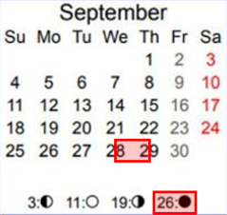

LUNAR TRUMPETS
29 CE/30 CC
Note the 4th cycles!
The next few slides
will be verifying accurate alignment of the linear display to the Roman calendar. This is precisely to determine the correct cycles of
the week so they can
be clearly understood.
Lunar Trumpets!
L
U
N
A
R
Cycle Lunar Date
4^{th at sunset} 1
5th 2
6th 3
7th 4
1st 5
2nd 6
3rd 7
4th 8
5th 9
6^{th at sunset} Lunar Atonement 10
7th 11
1st 12
2nd 13
3rd 14
4^{th at sunset} Lunar Sukkot (1) 15
5th (2) 16
6th (3) 17
7th (4) 18
7th Month
Sep 28/29 - Trumpets
Again: Lunar Trumpets started at sunset of
Sept 28th - and the
Light Season observation continued on the 4th cycle: 29th of Sept.

Slide 13
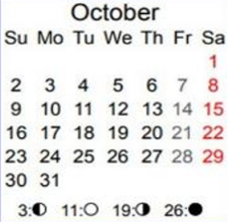
LUNAR ATONEMENT
29 CE/30 CC
Note the 6th cycles!
Oct 7/8 Yom Kippur
Cycle Lunar Date
L
U
N
A
R
4th 1
5th 2
6th 3
7th 4
1st 5
2nd 6
3rd 7
4th 8
5th 9
6^{th at sunset} Lunar Atonement 10
7th 11
1st 12
2nd 13
3rd 14
4^{th at sunset} Lunar Sukkot (1) 15
5th (2) 16
6th (3) 17
7th (4) 18
Oct 8th is the
10th day/season of
the 7th Lunar month.
Lunar
Atonement!
7th Month
Lunar Atonement started at sunset on Oct 7th and the Light Season observation would have continued
on Oct 8th - the weekly Shabbat.

Slide 14

LUNAR SUKKOT
29 CE/30 CC
Note the 4th cycles!
Note the blue box: the “approximate” midst of Sukkot’s 7 day festival week!
Cycle Lunar Date
L
U
N
A
R
4th 1
5th 2
6th 3
7th 4
1st 5
2nd 6
3rd 7
4th 8
5th 9
6^{th at sunset} Lunar Atonement 10
7th 11
1st 12
2nd 13
3rd 14
4^{th at sunset} Sukkot (1) 15
5th (2) 16
6th (3) 17
7th (4) 18
7th Month
Oct 12-19 - Sukkot
Lunar Sukkot started at sunset on Oct 12th and the
Light Season observation would have continued on
Oct 13th as the 5th cycle.
Lunar Sukkot!
Sukkot is a 7 day Festival
followed by “The Last Great Day.”

Slide 15

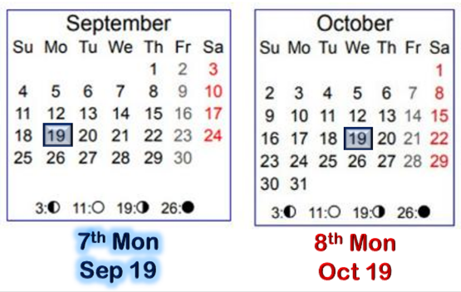
The Lunar Fall Festival dates are concluded.
Next: A comparison
of the dates on
Covenant Calendar.

Slide 16

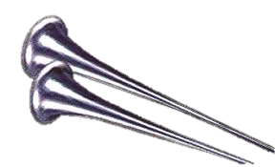
COVENANT TRUMPETS
Cycle C C Date
Cycle C C Date
1st 30
6th Month
Note the Cycle!
2nd TRUMPETS! 1
3rd 2
4th 3
5th 4
6th 5
7th 6
Chodesh
The Roman calendar reckoning starts a cycle
at midnight. Therefore, Trumpets on a Roman Calendar started at midnight of the 18th
in CE 29. The Light Season of observation of Trumpets would have been on the 19th.
See chart on right side.
New Month Day
7th Month
Sep 19 Trumpets
7th Month & 1st Day
Sep 19 Trumpets
29 CE/30 CC

Slide 17
COVENANT ATONEMENT
Cycle C C Date
2nd 1
3rd 2
4th 3
5th 4
6th 5
7th 6
1st 7
2nd 8
3rd 9
4th 10
5th 11
6th 12
7th 13
New Month Day
The Roman calendar reckoning starts a cycle
at midnight. Therefore, Atonement on the Roman Calendar, started at midnight of the 27th
in CE 29. The Light Season of observation of Trumpets would have been on the 28th.
7th Chodesh
Atonement
7th Month & 10th Day
Sep 28 Yom Kippur
29 CE/30 CC

Slide 18
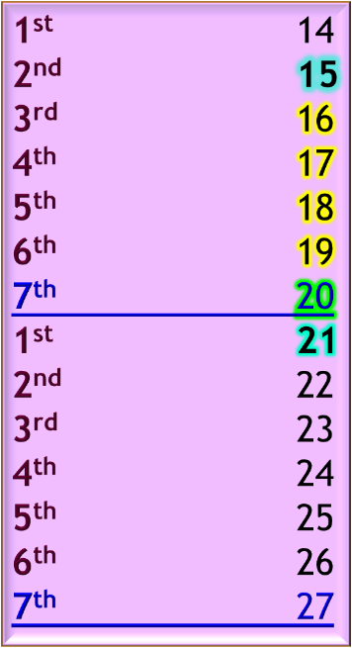
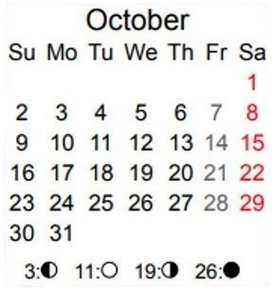
COVENANT SUKKOT
Cycle C C Date
7th Month
The Roman calendar reckoning starts a cycle at midnight. Therefore in CE 29, Sukkot on the Roman Calendar started at midnight
of Oct 2nd.
The Light Season for observation of Sukkot would have been
on Oct 3rd.
Tabernacles
Shemini Atzeret
Last Great Day
22
29 CE/30 CC
7th Month & 15th - 22nd Days
Oct 3-9 Sukkot
Oct 10 Last Great Day

Slide 19
Keeping in mind that you have just observed documentation of Roman dates for the Lunar and Covenant Calendar timing of Sukkot, we are now ready to move forward in this teaching.
What cycle was
it when Yahusha arrived “about the midst of the
Jews’ feast”?
John 7:14

Slide 20
Cycle Lunar Date
Cycle C C Date
1st 13
2nd 14
3rd 15
4th 16
5th 17
6th 18
7th 19
1st 20
2nd 21
3rd 22
4th 23
5th 24
6th 25
7th 26
1st 27
2nd 28
3rd 29
29 CE/30 CC
2nd 24
3rd 25
4th 26
5th 27
6th 28
7th 29
1st 30
6th Month
6th Month
Lunar Trumpets!
2^{nd Sept 19 Trumpets} 1
3rd 2
4th 3
5th 4
6th 5
7th 6
1st 7
2nd 8
3rd 9
4^{th Sept 28 Yom Kippur} 10
5th 11
6th 12
7^{th Oct 1st} 13
1st 14
2^{nd Oct 3 Sukkot Shabbat} 15
3rd 16
4th 17
5th 18
6th 19
7th 20
1^{st Oct 9 Sukkot} 21
2^{nd Oct 10 Last Great Day} 22
3rd 23
4th 24
5th 25
6th 26
7^{th Oct 15 Shabbat} 27
7th Month
Lunar Atonement!
4^{th Sept 28 sunset} 1
5th 2
6th 3
7^{th Oct 1 sunset} 4
1st 5
2nd 6
3rd 7
4th 8
5th 9
6^{th Oct 7 sunset} 10
7^{th Oct 8 sunset} 11
1st 12
2nd 13
3rd 14
4^{th Oct 12 sunset} (1) 15
5th (2) 16
6th (3) 17
7^{th Shabbat at} ^{Oct 15 sunset} (4) 18
7th Month
Yahusha went up about the MIDST of their Lunar Feast, (feast of the Yahudim, John 7:1,14). Apparently Yahusha’s full intention
was to observe the
7th day Shabbat - the very next cyclE!
Lunar Sukkot!

Slide 21
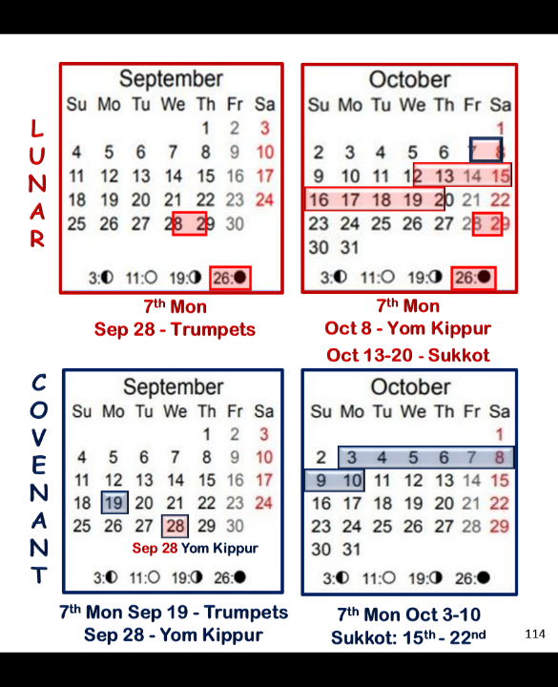

Cycle Lunar Date
29 CE/30 CC
Why did Yahusha make such
an accusation?
4th 1
5th 2
6th 3
7th 4
1st 5
2nd 6
3rd 7
4th 8
5th 9
6th 10
7th 11
1st 12
2nd 13
3rd 14
4^{th Oct 12 sunset} (1) 15
5th (2) 16
6th (3) 17
7^{th Oct 15 sunset} (4) 18
7th Month
Lunar Trumpets!
Lunar Sukkot!
Lunar Atonement!
Again!
Yahusha was TEACHING on the 7th day Shabbat.
Speaking to the scribes and Pharisees -
John 7:19 Did not Mosheh give you the Torah?
Yet NOT ONE OF YOU does the Torah!

Slide 22

Let’s compare Covenant Calendar Dates with the Lunar Dates.
Cycle Lunar Date
29 CE/30 CC
Cycle C C Date
4th 1
5th 2
6th 3
7th 4
1st 5
2nd 6
3rd 7
4th 8
5th 9
6th 10
7th 11
1st 12
2nd 13
3rd 14
4^{th Oct 12 sunset} (1) 15
5th (2) 16
6th (3) 17
7^{th Oct 15 sunset} (4) 18
4^{th Sept 2 Yom Kippur} 10
5th 11
6th 12
7^{th Oct 1} 13
1st 14
2^{nd Oct 3 Sukkot} (1) 15
3rd (2) 16
4th (3) 17
5th (4) 18
6th (5) 19
7th (6) 20
1^{st Oct 9 Sukkot} (7) 21
2^{nd Oct 10 Last Great Day} (8) 22
3rd 23
4^{th Oct 12 Lunar Sukkot Begins} 24
5th 25
6th 26
7^{th Oct 15} 27
7th Month
Lunar Trumpets!
Cov Yom Kippur
7th Mo
n
t
h
Lunar Sukkot!
Lunar Atonement!
Did you notice the Covenant Sukkot ended
4-5 days before the approx middle of
Lunar Sukkot?
Covenant Sukkot ends [2] days before Lunar Sukkot begins.
Do you think Yahusha might have said -
NOT ONE OF YOU were in the temple for My Sukkot Festival?
Question

Slide 23
As it appears in the Scripture, Yahusha had full intention of observing the 7th day Shabbat after His arrival in Yerushalayim.
The question now surfaces: Would Yahusha normally travel from Galilee to Yerushalayim just to observe a 7th day Shabbat?
Scripture records that Yahusha was IN THE TABERNACLE teaching. Could it be that Yahusha was WITNESSING to the importance of the 7th day Shabbat?
By Scriptural statement & example we know there were TORAH BASED BELIEVING Jews at this time in the land of Israel. These BELIEVERS, would have been unable to honor Covenant Calendar Sukkot at the temple at this time!
What are their options?

Slide 24

We have seen Yahusha arrive at Jerusalem in time for
the weekly Shabbat of
Lunar Sukkot.
Did His followers travel
with Him to worship
at the temple in
Jerusalem on Shabbat?

Slide 25
What about the Believing Jews?
Is it possible that Yahusha would associate with these Torah believing Jews for Sukkot wherever they were?
Instead of worshipping at the Jerusalem temple,
were these believing Jews in disobedience to
worship Yahusha wherever he was at?
When they were with Yahusha were they in close proximity to the greatest Tabernacle of all?
Would Yahusha have His own reasons to be in close proximity and “tabernacle” (dwell and fellowship) with those that believed in Him?

Slide 26

What about Believing Yahusha’s Words?
John 2:19-22 Yahusha answered and said unto them,
Destroy this temple, and in three days I will raise it up.
20 Then said the Jews, Forty and six years was this temple
in building, and wilt thou rear it up in three days?
21 But he spake of the temple of his body. KJV
Compare to:
John 4:21 Yahusha saith unto her, Woman, believe me,
the hour cometh, when ye shall neither in this mountain,
nor yet at Jerusalem, worship the Father.
Who is THE Father?
Isa 9:6 For unto us a Child is born, unto us
a Son is given: and the government shall be upon His shoulder: and His name shall be called Wonderful, Counseller, The mighty Elohim, The everlasting Father, The Prince of Peace.

Slide 27

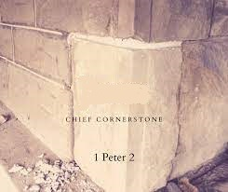
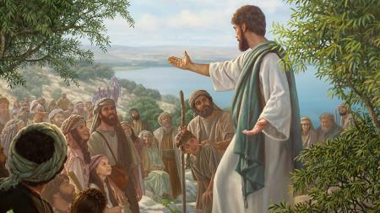
John 1:1 In the beginning was the Word, and the Word was with God, and the Word was God.
John 2:21 But he spake of the temple of his body.
John 1:14
And the Word was made flesh, and dwelt among us, (and we beheld his glory, the glory as of the only begotten of the Father,) full of grace and truth.
Eph 2:20 And are built upon the foundation of the apostles and prophets, Jesus Christ himself being the chief corner stone;
1 Peter 2:6 Wherefore also it is contained in the scripture, Behold, I lay in Sion a chief corner stone, elect, precious: and he that believeth on him shall not be confounded.
Ps 118:22 The stone which the builders refused is become the head stone of the corner.
Mark 12:10 And have ye not read this scripture; The stone which the builders rejected is become the head of the corner:
Isa 9:6 For unto us a child is born, unto us a son is given: and the government shall be upon his shoulder: and his name shall be called Wonderful, Counseller, The mighty God, The everlasting Father, The Prince of Peace.
Matt 9:18 While he spake these things unto them, behold, there came a certain ruler, and worshipped him, saying, My daughter is even now dead: but come and lay thy hand upon her, and she shall live.
Matt 28:9 And as they went to tell his disciples, behold, Jesus met them, saying, All hail. And they came and held him by the feet, and worshipped him.
Mark 5:6 But when he saw Jesus afar off, he ran and worshipped him,
A Few Questions About Yahusha
Was Yahusha the WORD? (John 1:1)
Was Yahusha the temple? (John 2:21)
Was Yahusha the tabernacle? (John 1:14)
Was Yahusha the cornerstone? (Eph 2:20; 1 Pet 2:6)
Was Yahusha the rejected corner stone? (Ps 118:22; Mark 12:10)
Was Yahusha the Everlasting Father? (Isa 9:6)
Did Yahusha deserve to be worshipped
wherever He was at? (Matt 9:18; 28:9; Mark 5:6)
  It is very likely His disciples
  were with Him the full time;
  worshipping in grand adoration.
Yahusha
Yes!
Notes:
Ephesians 2:20 20 And are built upon the foundation of the apostles and prophets, Jesus Christ himself being the chief corner stone;
1 Peter 2:6 6 Wherefore also it is contained in the scripture, Behold, I lay in Sion a chief corner stone, elect, precious: and he that believeth on him shall not be confounded.
Psalms 118:22 22 The stone which the builders refused is become the head stone of the corner.

Slide 28

29 CE/30 CC
We know this for sure:
NOT ONE of the
[unb] JEWS were in the temple for Yahusha’s Sukkot Festival ~ because Lunar Sukkot began 2 days AFTER Covenant Sukkot ended!
Cycle Lunar Date
Cycle C C Date
4th 1 Trumpets
5th 2
6th 3
7th 4
1st 5
2nd 6
3rd 7
4th 8
5th 9
6th 10 Yom Kippur
7th 11
1st 12
2nd 13
3rd 14
4^{th Oct 12 sunset} (1) 15 1st Sukkot
5th (2) 16
6th (3) 17 Fri Sunset
7^{th Oct 15 sunset} (4) 18 Sab Sunset
4^{th Sept 2 Yom Kippur} 10 Yom Kip
5th 11
6th 12
7^{th Oct 1} 13
1st 14
2^{nd Oct 3 Cov Sukkot Sabbath} (1) 15 1st Suk Sab
3rd (2) 16
4th (3) 17
5th (4) 18
6th (5) 19
7th (6) 20
1^{st Oct 9 Cov Sukkot Ends} (7) 21
2^{nd Oct 10 Last Great Day} (8) 22 Last Gt Day
3rd 23
4^{th Oct 12 Lunar Sukkot Begins} 24
5th 25
6th 26
7^{th Oct 15} 27
7th Month
7th Mo
n
t
h
But, where
was Yahusha?
Yahusha was observing His 7th day Shabbat – TEACHING! He was using every opportunity to be with the multitudes when they were gathered at the temple!
… about the midst of the feast [on Shabbat] Yahusha went up into the[ir] temple, and taught.

Slide 29

No wonder John recorded these very important details not
found in the other 3 Gospels!
But that’s not all!
After Yahusha
declared His divinity, He said …

Slide 30
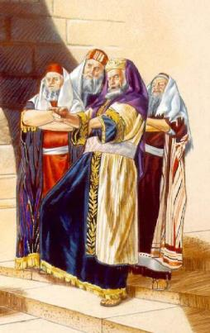
John 7:19 Did not Mosheh give you the Torah, and yet not one of you does the Torah?
Why do ye go about to kill me?
Yahusha did not leave Jerusalem for several more days! Why not?
But, there’s
more!

Slide 31

This Lunar Calendar - for Sukkot was occurring at the exact same time, that Yahusha would witness against it!
Recall John 7:6 where Yahusha declared that - He witnessed of
(the lunar based calendar of the [unb] Jews); that it was – WICKED!
The Lunar Last Great Day will be recorded next!
Will Yahusha WITNESS through:
His WORD?
His words?
OR by EXAMPLE THROUGH HIS ACTIONS?
Or – “all of the above”?
Something very interesting is about to happen
after we gather some information!
31

Slide 32
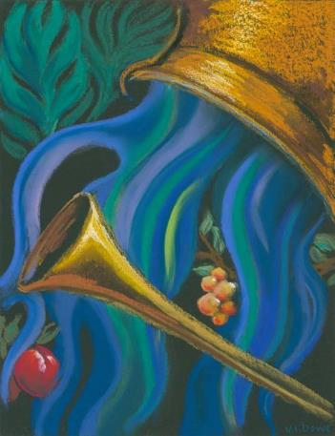
Lunar “Last Great Day” Ceremony
In the second temple period, a water libation ceremony during Sukkot
had developed which had become tradition by the time of Yahusha.
In this ceremony, the priests would draw water from the Pool of Siloam; carry it up to the Temple; pour the water onto the altar along with wine from another bowl.
The ceremony refers to this passage in Isaiah 12:
“Behold, Elohim is my salvation; I will trust, and
will not be afraid; for Yahuah Elohim is my strength
and my song, and he has become my salvation.”
With joy you will draw water from the wells of
salvation.” (Isaiah 12:2-3)

Slide 33

Will we recognize Yahusha IN ACTION,
or, worship [?],
in the vain lunar based lies of tradition?
7th Month
What did Yahusha do at this water ceremony?
Cycle Lunar Date
1^{st Oct 16sunset}(5) 19
2nd (6) 20
3rd (7) 21
4^{th Oct 19LGDay}(8) 22
5th 23
6^{th Oct 21sunset} 24
7^{th Oct 22 sunset} 25
Is it POSSIBLE YAHUSHA WAS
WITNESSING?
What Did He Say?

Slide 34
Water Libation Ceremony
John 7 chronicles the Feast of Tabernacles of Yahusha’s earthly ministry. He had arrived “about
the midst of the week” – determined to be “on time” and “very visible” (in a teaching format), for the Last Great Day of the Jews’ festival.
It was typical for Jewish teachers in those days to instruct their disciples from a seated position. Yahusha must take advantage at this great gathering to reach the multitudes in the hearing
of the priests and leaders that were intent on
killing Him. How did He do this?
In a very remarkable way!
Yahusha delivered His words by standing up! Yahusha indicated that He was making an important announcement that everyone must hear, even though He knew that it would anger some of those present who sought to take His life.
Verses 37-38 record: “In the last day, that great day of the feast, Yahusha stood and cried, saying,
if any man thirst, let him come unto me, and drink.
He that believeth on me, as the scripture hath said,
out of his belly shall flow rivers of living water.”
Speaking in a loud voice, Yahusha’s statements caused great amazement and controversy among His audience (v. 40-53).
The stunned crowd did hear and many asserted that He must be the Messiah, spoken of by Moses in Deut 18:15, 18. Officers who had been ordered by religious authorities to arrest Yahusha, (v. 32) returned to their superiors emptyhanded.
When asked why they had not seized Him, they answered, “No one ever spoke the way this man does” (v. 46).

Slide 35
Water Libation Ceremony (con’t)
Even though Yahusha’s proclamation in John 7 elicited a strong response, His words also aligned well with the customs of the water libation ceremony, where water and wine were poured before the altar.
He inferred: 1) He was the fulfillment of the typology of the
Exo 17 miracle when “Living Water” came from the rock at Horeb.
He also meant: 2) the pouring
of the “water and wine” typified the “water and blood” that would pour forth from His pierced “side” at His crucifixion – the very next festival.
It is no coincidence that Yahusha chose the
last and greatest day of Sukkot to make this declaration proclaiming Himself to be the Great Provider in the wilderness; the Great Light shining in the darkness up in Galilee; and His body as the great Temple to receive worship.
Yahusha did NOT attend to “worship” but to declare “WHO” He was,
and to receive worship from those who believed in Him. He was
DIRECTLY WITNESSING
against the festival of the current counterfeit lunar calendar!
Let’s find out a bit more of what Yahusha said.

Slide 36
Yahusha Must Declare Exactly Who He Is
Yahusha proclaims He is the Messiah: Everyone who would believe in Him would receive
the indwelling of Himself, as
the Ruach, the “Living Water,"
the true “Life Giver” (John 7:39).
Yahusha is the Creator:
In Jer 2:13, Yahuah referred to Himself as “the fountain of Living Waters.” By calling Himself the source of Living Waters, Yahusha was also indirectly asserting His divinity as “the One” that moved across the waters in the Gen 1:2b restoration.
Yahusha is The Foundation Stone and Cornerstone: Just as Yahusha identified Himself with the temple in John 7, He also identified Himself with its Foundation Stone. He was the Pierced Rock from which Living Waters would flow (Ps 78:20; John 19:34), the Stone that would be rejected and become the Chief Cornerstone
(Ps 118:22-23; Matt 21:42, I Peter 2:7).
Yahusha is the new Temple: Yahusha had previously referred to His body as a temple (John 2:19-22), and He finalizes this connection
in John 7. If Ezekiel’s temple had been built, Yahusha would have been the fulfillment of the living waters that were to emanate from that temple as the Source of living waters.

Slide 37

It is now time to compare the Lunar Calendar dates with the Covenant Calendar dates to determine why John has been so careful to document
this event with
incredible detail.
Cycle Lunar Date
Cycle C C Date
1^{st Oct 16 sunset}(5) 19
2nd (6) 20
3rd (7) 21
4^{thOct 19LGDay}(8) 22
5th 23
6^{th Oct 21 sunset} 24
7^{th Oct 22 sunset} 25
1^{st Oct 16} 28
2nd 29
3rd 30
7th Month
7th Month
4^{th Oct 19} 1
5th 2
6^{th Oct 21} 3
7th SHABBAT! 4
8th Month
Lunar Last Great Day
What is happening on the exact same dates of these 2 calendars?

Slide 38
Cycle Lunar Date
Next: Yahusha did not attend the lunar last great day to observe their wicked festival!
Yahusha made His appearance at
the Jews’ Lunar
Last Great day -
TO TEACH
(John 7:37)
and to reach the
Multitudes!
Cycle C C Date
1^{st Oct 16 sunset}(5) 19
2nd (6) 20
3rd (7) 21
4^{th Oct 19LGDay}(8) 22
5th 23
6^{th Oct 21 sunset} 24
7^{th Oct 22 sunset} 25
1^{st Oct 16} 28
2nd 29
3rd 30
7th Month
4^{th Oct 19} 1
5th 2
6^{th Oct 21} 3
7th SABBATH! 4
8th Month
Lunar Last Great Day!
7th Month
Come out
of Babylon!
IMPLORE
“If anyone thirsts, let him come to Me, and let him who believes in Me drink!” John 7:37

Slide 39
Cycle Lunar Date
Cycle C C Date
1^{st Oct 16 sunset}(5) 19
2nd (6) 20
3rd (7) 21
4^{th Oct 19LGDay}(8) 22
5th 23
6^{th Oct 21 sunset} 24
7^{th Oct 22 sunset} 25
1^{st Oct 16} 28
2nd 29
3rd 30
“If anyone thirsts, LET HIM COME TO ME!”
7th Month
4^{th Oct 19} 1
5th 2
6^{th Oct 21} 3
7th SABBATH! 4
8th Month
OR, was
Yahusha
saying this to the unbelievers?
Lunar Last Great Day!
7th Month
Come out of Babylon My people! Did you notice I did not observe YOUR EVIL festival?
I was PROTESTING AND WITNESSING against it!

Slide 40
More Points to Ponder
When Yahusha went up at the middle of their feast, is it possible Yahusha intended to “light all the candles of the menorah with one match”?
Yahusha was not there to observe their lunar festival! He attended specifically for a PRIME OPPORTUNITY to expressly WITNESS to the people all in one sitting.
The congregation was there to listen. Yahusha used this opportunity to appeal to their intellect and convictions.
Come to Me! Forget the Pharisees and Sadducees who He emphatically declared as – blind guides! Matt 23:16
Moving forward into the next part for Covenant Calendar.

Slide 41
Cycle Lunar Date
It was now the
8th cycle of the lunar
Sukkot of the [unb] Jews.
A question surfaces: Where would the BELIEVING Jews
be on the Day of their 8th Rosh Chodesh?
Cycle C C Date
1^{st Oct 16 sunset} (5) 19
2nd (6) 20
3rd (7) 21
4^{th Oct 19LGDay}(8) 22
5th 23
6^{th Oct 21 sunset} 24
7^{th Oct 22 sunset} 25
1^{st Oct 16} 28
2nd 29
3rd 30
7th Month
7th Month
4^{th Oct 19 BLOW the TRUMPETS} 1
5th 2
6^{th Oct 21} 3
7th SABBATH! 4
8th Month
Num 10:10 Also in the day of your gladness, and in your
solemn days, and in the beginnings of your months,
ye shall blow with the trumpets over your burnt offerings,
and over the sacrifices of your peace offerings; that they
may be to you for a memorial before your Elohim:
I am יהוֹה.[Yahuah] your Elohim.

Slide 42
Where do we read that BURNT OFFERINGS must be
presented before Yahuah –
IN THE PLACE WHERE HE CHOOSES TO PLACE HIS NAME?
Lev 1:3 If his offering be a burnt sacrifice of the herd,
let him offer a male without blemish: he shall offer it of
his own voluntary will at the door of the tabernacle
of the congregation before [Yahuah].
Is it safe to say that the believing Jews would be offering
burnt sacrifices on the 1st cycle of the 8th month?
Is it also safe to understand that Yahusha would be
teaching and fellowshipping with these believing Jews
IN THE TABERNACLE - supporting them since He was in the area?

Slide 43
Is it possible that Yahusha was
IN THE TABERNACLE – (fellowshipping)?
Is there a second witness that BURNT OFFERINGS MUST be slain
IN THE PLACE WHERE HE CHOOSES TO PLACE HIS NAME?
Exo 20:24 An aulter of earth thou shalt make vnto me, and theron offer thy burnt offeringes, and thy peace offeringes, thy sheepe,
and thyne oxen: In all places where
I SHALL PUT THE REMEMBRAUNCE OF MY NAME,
thyther I wyll come vnto thee, and blesse thee. [Bishop’s 1568]
Burnt offerings were required for the first of the month celebrations.
Burnt offerings were required to be sacrificed at the Tabernacle.
Could we expect to have seen Yahusha fellowshipping alongside the believing Jews on this day of the 8th Rosh Chodesh?

Slide 44
Cycle Lunar Date
29 CE/30 CC
Cycle C C Date
1^{st Oct 16 sunset}(5) 19
2nd (6) 20
3rd (7) 21
4^{th Oct 19LGDay}(8) 22
5th 23
6^{th Oct 21 sunset} 24
7^{th Oct 22 sunset} 25
1^{st Oct 16} 28
2nd 29
3rd 30
7th Month
Did Yahusha observe Covenant Calendar
8th Rosh Chodesh,
IN THE TABERNACLE?
He was
in the vicinity!
Would He fellowship with like-minded believers?
7th Month
4^{th Oct 19 BLOW the TRUMPETS} 1
5th 2
6^{th Oct 21} 3
7th SABBATH! 4
8th Month
What are your thoughts?

Slide 45

Thus far it has been thoroughly documented, and shown, that Yahusha’s actions were a strong witness against the counterfeit lunar calendar of the Pharisees.
Conclusion laid out on the Roman Calendar!
Let’s put everything together on the Roman Calendar for confirmation.

Slide 46

Placement for the Festivals in the 7th Month for Both Lunar & Covenant Calendars Overlaid on the
Roman Calendar
L
U
N
A
R
A Review
of what has been covered thus far.
7th Mon
Sep 28/29 - Trumpets
7th Mon
Oct 7/8 - Yom Kippur
Oct 12-20 - Sukkot
COVENANT
Sep 28 Yom Kippur
29 CE/30 CC
7th Mon Sep 19 - Trumpets
Sep 28 - Yom Kippur
7th Mon Oct 3-10
Sukkot: 15th - 22nd
Notes:
Emailed to tim dec 23/22 to note what is happening between the two calendars.

Slide 47

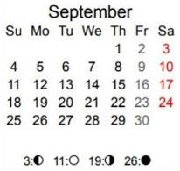
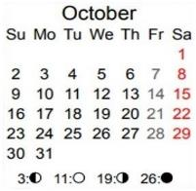
Final Comparison of Lunar & Covenant Calendars Overlaid
on the Roman Calendar
L
U
N
A
R
RED
John 7:14
Now about
the midst of the [Jews’] feast Yahusha went up into the temple, and taught.
7th Mon
Sep 28/29 Trumpets
Oct 7/8 - Yom Kippur
Oct 12-20 - Sukkot
COVENANT
B
LUE
Sep 28 Yom Kippur
7th Mon
Sep 19 Trumpets
Oct 3-10
Sukkot: 15th - 22nd

Slide 48
Putting It All Together
Oct 14th: [Friday] Yahusha arrived at Jerusalem right on time to teach in the temple the next day for the weekly Shabbat.
Oct 15th: Sabbath is indeed “about the midst of the [Jews’] feast.” Therefore, the 1st month of their lunar calendar was calculated using the crescent moon AFTER the spring tequfah.
Oct 19 & 20: On Oct 19th, Yahusha also honored the 8th Rosh Chodesh of Covenant Calendar [in the temple], and was present Oct 20th for the Last Great Day of the lunar calendar. This was a prime opportunity for Him to appeal to the multitudes to accept Him as their Messiah, THE “Water of Life.”
L
U
N
A
R
RED
COVENANT
B
LUE

Slide 49
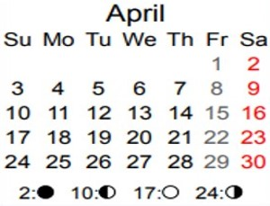
Comparison of Lunar & Covenant Calendars
For Passover, these 2 calendars are about 12/13 days apart.
For Trumpets, these 2 calendars are about 9/10 days apart.
29 CE/30 CC
1st Month Passover
Cov Cal Apr 5 Lun Cal Apr 17/18
7th Month Trumpets
Cov Cal Sep 19 Lun Cal Sep 28/29

Slide 50

Comparison of Lunar & Covenant Calendars
For Passover, these 2 calendars are about 12/13 days apart.
For Trumpets, these 2 calendars are about 9/10 days apart.
29 CE/30 CC
By Passover 30 CE, these
2 calendars will be only 12 hours apart!
1st Month Passover
Cov Cal Apr 5 Lun Cal Apr 17/18
7th Month Trumpets
Cov Cal Sep 19 Lun Cal Sep 28/29

Slide 51
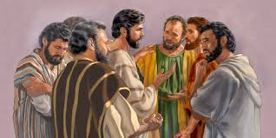
A Closer Look at the Seventh Month Travel Plans
Now the Jews' feast of
tabernacles was at hand.
His brethren therefore said
unto him, Depart hence,
and go into Judaea …
29 CE/30 CC
?
?
7th Month Trumpets
Cov Cal Sep 19 Lun Cal Sep 28/29
When did the
brethren utter
this statement?
Before a Trumpets?

Slide 52
Questions for: “…the Jews' feast of tabernacles was at hand.”
Did these brethren plan to be:
… in Jerusalem several days before the lunar trumpets at sunset Sept 28th?
If so, when would they leave on this 5-6 days journey so as to arrive early and not travel on a weekly Shabbat?
IF they arrive 6 days early for lunar Trumpets, that would be on Sept 22nd.
Needing 5-6 days for travel, for an arrival
on Sept 22nd, that means they would have to leave at least by Sept 15th.
29 CE/30 CC
?
?
7th Month Trumpets
Cov Cal Sep 19 Lun Cal Sep 28/29
Note: This is before Covenant Trumpets on Sept 19th!

Slide 53
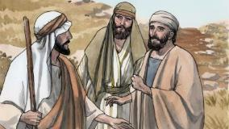
29 CE/30 CC
?
Thus the question:
When did the
brethren utter
their statement?
?
If the brethren wanted to be in Jerusalem early for lunar trumpets, they would have
had to ask their question at least
by Sept 15th.
7th Month Trumpets
Cov Cal Sep 19 Lun Cal Sep 28/29
… is “the Jews’ feast of tabernacles still – at - hand”?
Then:

Slide 54
L
U
N
A
R
RED
Similar questions exist
if the brethren decide to
be early for Yom Kippur!
On a Jubilee year, it is reasonable to
assess the brethren would want to be
in Jerusalem for lunar Yom Kippur?
However, to travel for 5-6 days and
arrive before sunset of Oct 7th, they
have three Sabbaths to consider (Sept 28th Trumpets; Oct 1st Shabbat & sunset Oct 7th).
COVENANT
B
LUE
Question: When do you think
the brethren would have left?

Slide 55
L
U
N
A
R
RED
The brethren realize they are commanded
to be at Tabernacles to build their sukkot!
They still have 5-6 days to travel.
To be at Jerusalem 5-6 days early,
they have many Sabbath days to honor
with rest (Sept 28th Trumpets; Oct 1st Shabbat & Yom Kippur Oct 8th).
Their question is even
more complicated
for Sukkot.
COVENANT
B
LUE
Question: When do you think the brethren would have left Galilee?

Slide 56

It appears in
all three cases …
they quizzed Yahusha before either Trumpets!
The brethren must have posed their request to Yahusha around Sept 15th with departure
soon after!
29 CE/30 CC
?
?
7th Month Trumpets
Cov Cal Sep 19 Lun Cal Sep 28/29
However, Yahusha didn’t seem to be
in a rush to go anywhere until “His Time”!

Slide 57
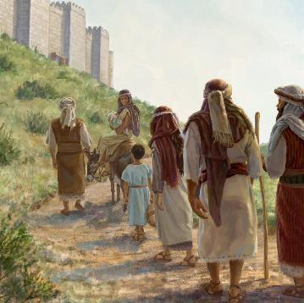
Were the brothers asking Yahusha to depart and arrive at their Sukkot on time even though He said He was not going with them? So …
L
U
N
A
R
RED
COVENANT
B
LUE
When did
the brethren
leave
Galilee?

Slide 58
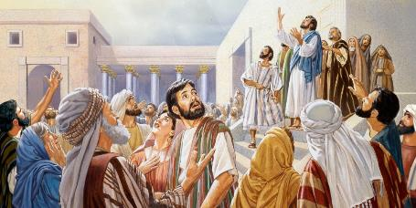

?
L
U
N
A
R
RED
When did
Yahusha leave
to arrive for
Oct 15 Shabbat?
Question: Considering the journey will
be 5-6 days, without travelling on any Shabbats, when must the departure date
be to arrive at the temple on time for:
Trumpets? Yom Kippur? Sukkot?
COVENANTP
B
LUE
We know when Yahusha arrived!
Is there a reason to know when He left?
Was He attending for “His Time” or not?

Slide 59

Remember Yahusha replied:
“My time is not yet come!”
When Yahusha said,
“My time”
was He talking
about Lunar Sukkot?
NO!

Slide 60

it fulfilled
His witness!
Yahusha did not
have to attend
any Lunar Feasts
Unless…
Lunar Sukkot was not His Time!

Slide 61
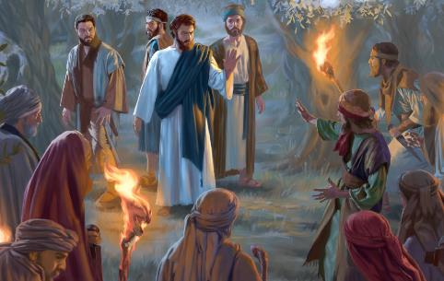
John 7:30 has the answer
to “His Time”
“So they were seeking to seize Him, but no one laid a hand on Him, because His hour HAD NOT YET COME.
There are TWO times that must be considered here:
Yahusha’s “time” when
He allows wicked hands
to seize Him.
… And …

Slide 62
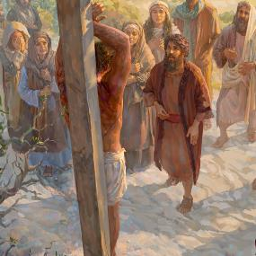
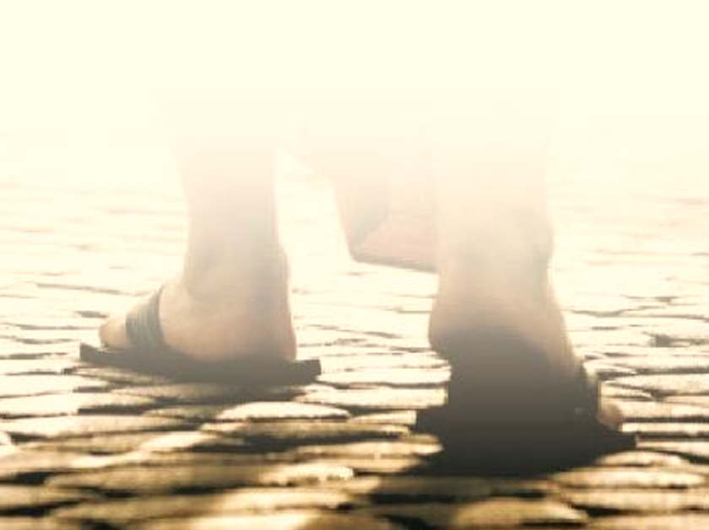
2. Yahusha’s “time” when He allows wicked hands to nail Him to the tree.
Yes!
Yahusha had only
ONE time when His steps would
take Him to Jerusalem for
Covenant Festival timing.
Covenant
Passover
That would be “His Time” - the very next festival of …
“My Time”!
The End of Part 3

Slide 63
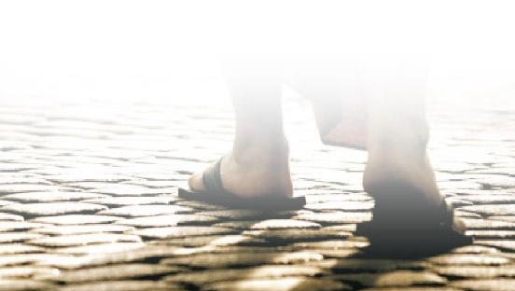
Did Yahusha’s Covenant Calendar in 29 CE
(for John 7) place His Feast of Trumpets on the fall tequfah, as some suggest?
Or was Covenant Trumpets on the
CYCLE FOLLOWING the fall Tequfah?
Coming up in Part 4:
“Come & See!”

Slide 64
Should we follow in His -
Question for - Part 4:
?
Again ~
“Come & See!”

Slide 65
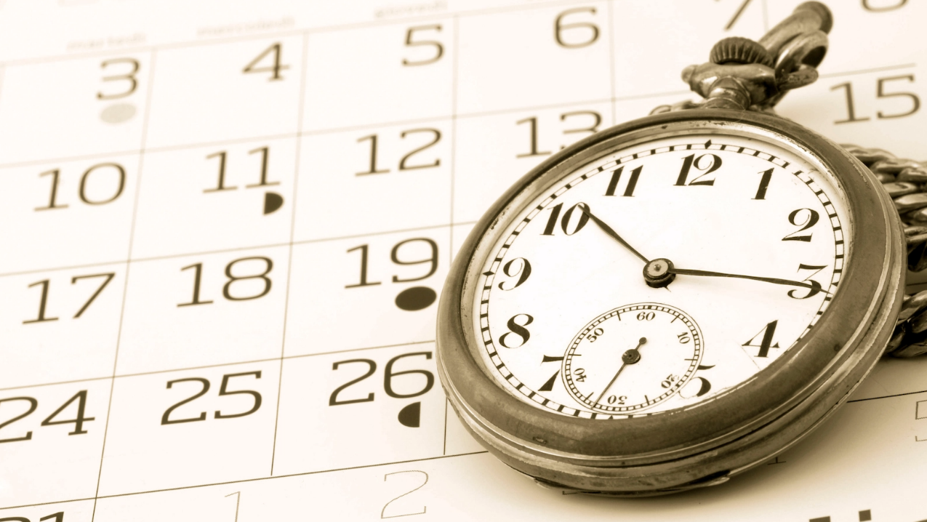


Please send any questions to:
Timothy Astleford &
Charlene Fortsch
questions@studythecalendar.com
Thank-you for being with us today!
Shalom!
65

